Slide 1
Data Mining & Warehousing
By
Prof. Dr. O.P.Vyas
DAAD Fellow (Germany), AOTS Fellow(Japan)
Indian Institute of Information Technology, Allahabad

Slide 2
D.M.W.
Data Mining
Overview of Data Engineering
RDBMS, Multi Dimensional Databases, OLAP, Data Warehouse
DM: Overview of Techniques
Algorithms & Implementations
Data Mining tools & D2K: Software Engineering
Association Rule Mining: Apriori Algorithm
Classification & Predictive mechanism
Clustering Analysis
Issues in DM : User-Centric Vs Procedure centric
Utility Mining issues
Rare item Problem:Single MinSup problem
B.I. : Business Intelligence
Business Intelligence
Business Planning & Forecasting Technologies
Computational Knowledge Discovery
Association Rules Vs. Business Rules.
Companies using Business Intelligence
Master Card, Wall Mart, Burger King,
Social Network Analysis & Data Mining

Slide 3
Data Mining, Data Analytics, Machine Learning & Business Intelligence

Slide 4
DM & ML
As a broad subfield of artificial intelligence, machine learning is concerned with the design and development of algorithms and techniques that allow computers to "learn".
The fundamental idea behind these approaches is to learn the theory automatically from the data, through a process of inference, model fitting, or learning from examples.
The major focus of machine learning research is to extract information from data automatically, by computational and statistical methods.
Machine learning approaches
Bayesian Belief networks
Neural networks-leads to Deep Learning
Hidden Markov Models
Vector Support machines
are best suited for domains characterized by the presence of large amounts of data, “noisy” patterns and the absence of general theories.
Thus they form a viable complementary approach to conventional methods.

Slide 5
DM & ML
Data mining relies on the use of real world data. This data is extremely vulnerable to co-linearity precisely because data from the real world may have unknown interrelations.
Though an unavoidable weakness of data mining is that the critical data that may explain the relationships is never observed.
Alternative approaches using an experiment based approach such as Choice Modeling for human generated data and careful Outlier Analysis may be used.
Inherent correlations are either controlled for or removed altogether through the construction of an experimental design. Data mining has been cited as the method by which the U.S. Army unit Able Danger supposedly had identified the September 11, 2001 attacks leader, Mohamed Atta, and three other 9/11 hijackers as possible members of an al Qaeda cell operating in the U.S. more than a year before the attack.

Slide 6
Machine Learning Approach
Machine learning methods are computationally intensive and benefit greatly from progress in computing speed.
Prevalence of Deep Learning approaches owe a lot to high computational power available on Laptops
At a general level, there are two types of learning: inductive, and deductive. Inductive machine learning methods extract rules and patterns out of massive data sets.
Hence, machine learning is closely related not only to data mining and statistics , but also Artificial Intelligence….

Slide 7
Machine learning Algos.
To the novice, machine learning methods may appear as a bag of unrelated techniques but they are not.
On the theoretical side , a unifying framework for for all machine learning methods has emerged since late 1980s. This is the Bayesian probabilistic framework for modeling and inference.
In fact there is little difference between machine learning and Bayesian modeling and inference, except for the emphasis on computers and number crunching implicit in the first term. It is the confluence of all three factors – data, computers, and theoretical probabilistic framework – that is fueling the machine learning expansion, in bioinformatics and elsewhere.
Machine learning approaches (e.g. Neural networks, Hidden Markov Models and Belief Networks) are ideally suited for areas in which there is a lot of data but little theory.

Slide 8
Machine Learning & Data Mining
The goal in machine learning is to extract useful information from a body of data by building good probabilistic models and to automate the process as much as possible
It is fair to say ML have started to have a significant impact with recent emergence of Deep Learning… .
An unprecedented wealth of data being generated has rather paved the way to Big Data Analytics, emerged as bonafde field of study combining various types of data
from by genome sequencing projects, Protein Structure database and other experimental efforts to determine the structure and function of biological molecules.
The demands and opportunities for interpreting these data are expanding more than ever.

Slide 9
Machine learning Algos.
Modeling biological data probabilistically makes eminent sense. One reason is that biological measurements are often inherently “noisy”, as is the case today of DNA microarray or mass spectrometer data. Sequence data on the other hand is becoming noise free due to it’s discrete nature and the cost effectiveness of repeated sequencing.
Thus measurement noise can not be the sole reason for modeling biological data probabilistically but the complexity and variability of biological systems. Biological systems have inherently a very high dimensionality.
Even in microarray experiments where expression levels of thousands of genes are measured simultaneously, only a small subset of the relevant variables is being observed. The majority of the variables remain hidden and must be factored out through probabilistic modeling. xiii

Slide 10
Business Intelligence is often developed on Data Analytic approaches..and is designed to address Business Issues
What is BI?
What BI can do?

Slide 11








Questions BI is Designed to Answer
What happened?
What is happening?
Why did it happen?
What will happen?
What do I want to happen?
Past
Present
Future
Data
ERP
CRM
SCM
3Pty
Black books

Slide 12
Business Intelligence…
BI is simply Data Analytics Applications to Business.
Right ??
No…not always !
Data Analytics though works as good foundation to many BI Solution but BI is more than Analytics.
How exactly BI is different from Data Analytics?
BI is an interdisciplinary area and requires understanding of Business processes appropriately combined to make BI work.
Well, Areas like Digital Marketing, Data Analytics combined with Business Processes with innovative approaches make it to BI !!
Notes:
12

Slide 13
Business Intelligence
Making useful, actionable insight from stored data.
Allows effective business decisions to be made.
The act of using historical data to gain new information.
Techniques include:
Multidimensional analyses
Mathematical modeling
Analytics
ad-hoc queries
'canned' reporting
Dashboards
What is Business Intelligence

Slide 14
Business Intelligence
Business intelligence (BI) refers to skills, technologies, applications and practices used to help a business acquire a better understanding of its commercial context.
In 1989 Howard Dresner (Later a Gartner Group analyst) proposed BI as an umbrella term to describe "concepts and methods to improve business decision making by using fact-based support systems." It was not until the late 1990s that this usage was widespread.
Business Intelligence is being discussed in conjunction with Advanced Data Analysis tools, Data Mining approaches and Advanced Visualization techniques for more informed and “insightful” business decision making.

Slide 15
Data Analytics in Today’s Business Whether it‘s B2B or B2C, Analytics has positioned itself in significantly . It would be essential for the Business today to have good understanding of how does a Analytics‘ technique works? What are different Analytic approaches... Predictive & Descriptive approaches ? What is Market Basket Analysis ?? What are it‘s Strength & Limitations in Business Context ?

Slide 16
Data Base, Data Warehouse & Data Mining provides foundation for developing useful Business Intelligence Solutions..

Slide 17
Intelligence & Learning from Data
Intelligence can be obtained by learning from Data
Data and Learning from data is related with Data Analytics
What is Machine Learning….?

Slide 18
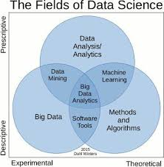
Analytics

Slide 19
Can Analytics tell me…?
For my Retail shop / Online shoppers, I wish to simply devise Discounting package can Analytics do it for me.
Not exactly but Analytics can tell you combination of some items sold often together which can eventually help you devising Discounting policies!
How can I understand the buying pattern of my Customer ?
Data Analytics through its various approach can bring hidden pattern in your purchase data to your knowledge.
I wish to prepare my future Stock of Items such that they are neither too much nor it’s too less for the customer demands, how can Analytic help me?
Well, techniques like Regression Analyses, Bayesian Classifiers etc with appropriate data can tell about future probability !!
What are different types of Analytics..?
Notes:
19

Slide 20
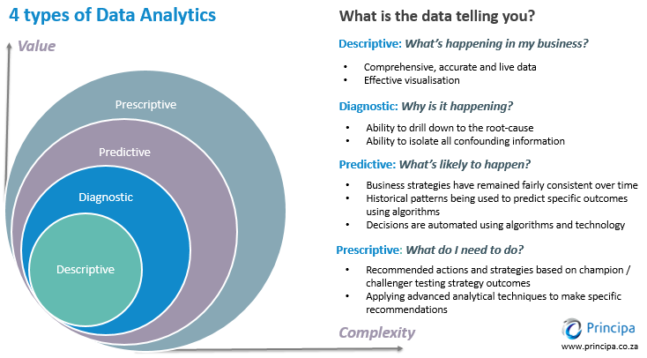

Slide 21
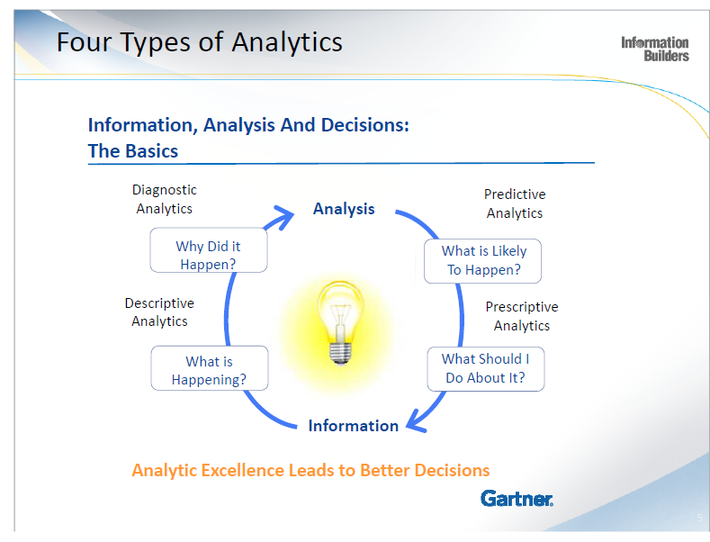

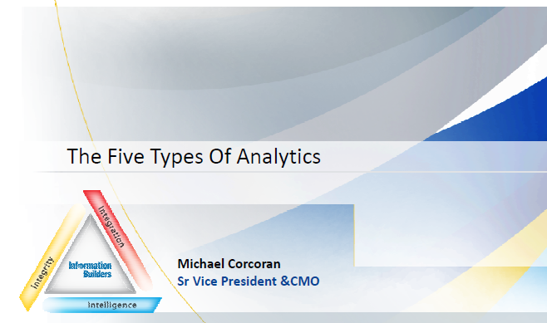

Slide 22
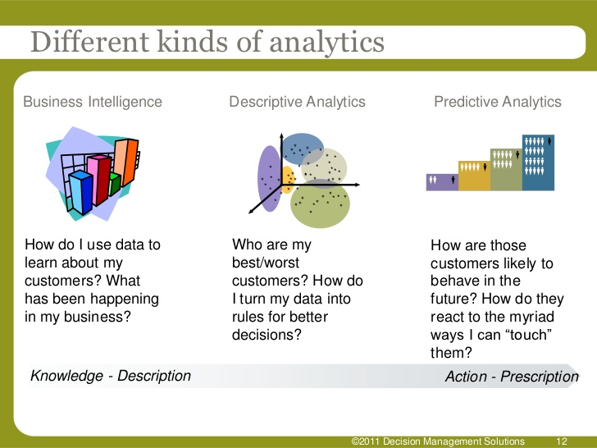

Slide 23
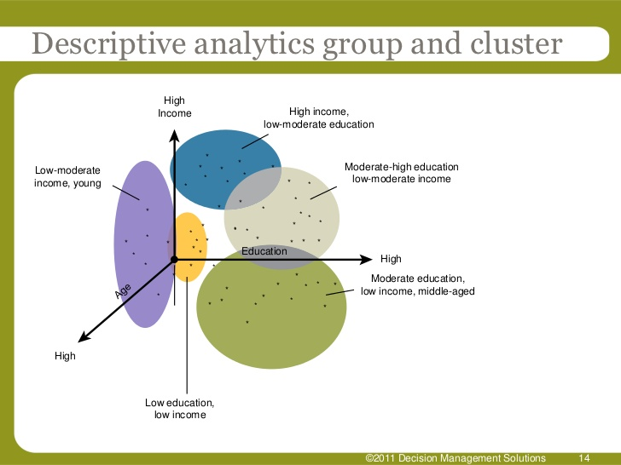

Slide 24
Let us know each other@IIIT NR
Learning Objectives
How does Descriptive Analytics namely a Association Rule Mining actually works ..?
What is Market Basket Analysis?
How to prepare Business Strategy from ARM results?
What is Learning- Machine Learning?
Supervised Learning, Unsupervised Learning?
Various Classifiers prevalent today for predictive Analytics ?
How can we predict prospective customers and future businesses?
What are different Attributes play role in a decision- Take a Credit Card Risk assessment case ?
Notes:
24

Slide 25
Data Mining & Data Analytics are often used interchangeably….
What is Data Mining ?
What are different approaches in Data Mining?

Slide 26
What Is Data Mining?
The process of automatically extracting unknown, and comprehensible information from large databases - Patterns;
“Torturing the data until they confess”
Data Mining is a Knowledge Discovery in Databases (KDD)
Integrative application of artificial intelligence
Building predictive models from data: machine learning
Let Data determines the theory….and not vice a versa..!!
Recognizing patterns, drawing conclusions, making recommendations : automated reasoning (inference)
Geared toward such applications as:
Anomaly detection (fraud, inappropriate practices, intrusions)
Crisis monitoring (terrorist activity, search and rescue, urban combat)
Decision support
What Data Mining Is Not
Data Base Management Systems: related but not identical field

Slide 27
Data Mining Approaches..
Data Mining
Descriptive
Predictive
Association
Rule Mining
Clustering
Analysis
Classification
Techniques
Asso.
Classifiers
27

Slide 28
Data Mining Functionalities
Descriptive
Association
Mining
Clustering
Predictive
Association Rule Mining is one of the most common and useful types of data mining.
The purpose is to determine the “inter-dependence” among various items.
Support-Confidence Framework
Apriori (Agarwal et.al. 1993),
Sequential pattern mining(Agarwal et.al.’95)
Hashing in Apriori (Park et.al. 1995a)
FP Growth (Han et.al. 2000): ARM without Candidate generation.
Classification
Techniques
Asso.Classifiers

Slide 29
Data Mining
Descriptive
Clustering
Predictive
Association
Mining
Clustering is the process of Grouping a set of (physical or abstract) objects into classes of similar objects
Spatial Data Mining & Web Mining
K-Means Algo (Mac-Queen et al., 1967)
CLARANS (Han et al., 1994)
DBSCAN ( Ester et al 1996)
Search Engine Result Mining
Clustering Search Result (Leouski and Croft, 1996, Zamir and Etzioni, 1997).
PageRank Algorithm – Google 1996
Classification
Techniques
Asso.Classification

Slide 30
Data Mining
Data Mining
Descriptive
Predictive
Association
Rule Mining
Classification mining analyzes a set of training data (i.e. a set of objects whose class labels are known) and constructs a model for each class based on the features in the data.
A set of classification rules are generated by the classification process, and these can be used to classify future data, as well as develop a better understanding of each class in the database.
Associative
Classification
Clustering
30

Slide 31
Data Mining Functionalities
Descriptive
Data Mining
Association
Mining
Clustering
Predictive
Techniques
Application Domain
Market Basket Analysis
Various products bought by a customer in a Supermarket were analysed for “interdependency”.
Mining Result is used for, Shelf space organization,formulating discounting-policies and for selective marketing.
What kinds of DNA are sensitive to this new drug?
Classification
Techniques
Assoc.
Classification

Slide 32
What Is Association Mining?
Association rule mining:
Finding frequent patterns, associations, correlations, or causal structures among sets of items or objects in databases, and other information repositories.
Proposed by Agrawal et al in 1993.
Applications:
Basket data analysis, cross-marketing, catalog design, loss-leader analysis, DNA analysis, clustering, classification, etc.
Examples.
Rule form: “Antecedent → Consequent [support, confidence]”.

Slide 33
Association Rules
Retail shops are often interested in associations between different items that people buy.
A person who bought the book Database System Concepts is quite likely also to buy the book Operating System Concepts.
Association information can be used in several ways.
E.g. when a customer buys a particular book, an online shop may suggest associated books.
Change in some parameters in blood may result in person getting diabetic, so such causal relationship may result in preventive medication.
Association rules:
bread ⇒ milk DB-Concepts, OS-Concepts ⇒ Networks
Left hand side: antecedent, right hand side: consequent
An association rule is a pattern that states when Antecedent occurs, Consequent occurs with certain probability.

Slide 34
Association Rules (Cont.)
Rules have an associated support, as well as an associated confidence.
Support is a measure of what fraction of the population satisfies both the antecedent and the consequent of the rule.
E.g. suppose only 0.001 percent of all purchases include milk and screwdrivers. The support for the rule is milk ⇒ screwdrivers is low.
We usually want rules with a reasonably high support
Rules with low support are usually not very useful
Confidence is a measure of how often the consequent is true when the antecedent is true.
E.g. the rule bread ⇒ milk has a confidence of 80 percent if 80 percent of the purchases that include bread also include milk.
Usually want rules with reasonably large confidence.
A rule with a low confidence is not meaningful.
Note that the confidence of bread ⇒ milk may be very different from the confidence of milk ⇒ bread, although both have the same supports.

Slide 35
A.R.M Algorithms:
A.R.M. was initially applied to Market Basket Analysis on transaction data of Supermarket sales using Apriori Algorithm.
Any algorithm should find the same set of rules although their computational efficiencies and memory requirements may be different. We study only one: the Apriori Algorithm
There are a large number of ARM Algorithms!!
They use different strategies and data structures.
Their resulting sets of rules are all the same.
Given a transaction data set T, and a minimum support and a minimum confident, the set of association rules existing in T is uniquely determined.

Slide 36
Data Mining Functionalities
Data Mining
Association
Mining
Clustering
Analysis
Classification
A:R:M:
Techniques
Application
domain
Classification
Techniques
Asso.Classifiers

Slide 37
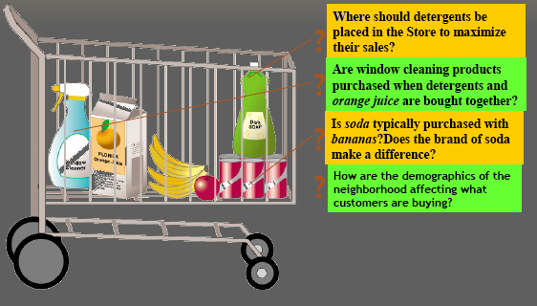
Application Domain
Market Basket Analysis
Various products bought by a customer in a Supermarket were analysed for “interdependency”.
Mining Result is used for, Shelf space organization, formulating discounting-policies and for selective marketing.
Classification
Techniques
Assoc.
Classification
37

Slide 38
Association Rules
Retail shops are often interested in associations between different items that people buy.
Someone who buys bread is quite likely also to buy milk
A person who bought the book Database System Concepts is quite likely also to buy the book Operating System Concepts.
Associations information can be used in several ways.
E.g. when a customer buys a particular book, an online shop may suggest associated books.
Association rules:
bread ⇒ milk DB-Concepts, OS-Concepts ⇒ Networks
Left hand side: antecedent, right hand side: consequent
An association rule must have an associated population; the population consists of a set of instances
E.g. each transaction (sale) at a shop is an instance, and the set of all transactions is the population

Slide 39
A.R.M.: Road map
Basic concepts of Association Rule Mining
Apriori algorithm
The model
Rule strength measures
Frequent itemset generation
Mining with user-defined inputs
Other A.R.M methods
A.R.M. Implementation websites

Slide 40
What Is Association Mining?
Association rule mining:
Finding frequent patterns, associations, correlations, or causal structures among sets of items or objects in databases, and other information repositories.
Proposed by Agrawal et al in 1993.
Applications:
Basket data analysis, cross-marketing, catalog design, loss-leader analysis, DNA analysis, clustering, classification, etc.
Examples.
Rule form: “Antecedent → Consequent [support, confidence]”.

Slide 43
Association Rules
Retail shops are often interested in associations between different items that people buy.
Someone who buys bread is quite likely also to buy milk
A person who bought the book Database System Concepts is quite likely also to buy the book Operating System Concepts.
Association information can be used in several ways.
E.g. when a customer buys a particular book, an online shop may suggest associated books.
Association rules:
bread ⇒ milk DB-Concepts, OS-Concepts ⇒ Networks
Left hand side: antecedent, right hand side: consequent
An association rule is a pattern that states when Antecedent occurs, Consequent occurs with certain probability.

Slide 44
Association Rules (Cont.)
Rules have an associated support, as well as an associated confidence.
Support is a measure of what fraction of the population satisfies both the antecedent and the consequent of the rule.
E.g. suppose only 0.001 percent of all purchases include milk and screwdrivers. The support for the rule is milk ⇒ screwdrivers is low.
We usually want rules with a reasonably high support
Rules with low support are usually not very useful
Confidence is a measure of how often the consequent is true when the antecedent is true.
E.g. the rule bread ⇒ milk has a confidence of 80 percent if 80 percent of the purchases that include bread also include milk.
Usually want rules with reasonably large confidence.
A rule with a low confidence is not meaningful.
Note that the confidence of bread ⇒ milk may be very different from the confidence of milk ⇒ bread, although both have the same supports.

Slide 45
Rule strength measures
Support: The rule holds with support sup in T (the transaction data set) if sup% of transactions contain X ∪ Y.
sup = Pr(X ∪ Y).
Confidence: The rule holds in T with confidence conf if conf% of tranactions that contain X also contain Y.
conf = Pr(Y | X)
An association rule is a pattern that states when X occurs, Y occurs with certain probability.

Slide 46
Mining Association Rules—An Example
Let us take the
Min. support 50%
Min. confidence 50%
For rule A ⇒ C :
support = support({A C}) = 50%
confidence = support({A C})/support({A}) = 66.6%
A ⇒ C (50%, 66.6%)
C ⇒ A (50%, 100%)
The Apriori principle:
Any subset of a frequent itemset must be frequent

Slide 47
Rule Measures: Support and Confidence
Customer
buys both
Customer
buys diaper
Find all the rules X & Y ⇒ Z with minimum confidence and support
support, s, probability that a transaction contains {X  Y  Z}
confidence, c, conditional probability that a transaction having {X  Y} also contains Z
Customer
buys beer
-- Let minimum support 50%, and minimum confidence 50%, we have
A ⇒ C (50%, 66.6%)
C ⇒ A (50%, 100%)

Slide 48
The Apriori Algorithm
Join Step: C_{k} is generated by joining L_{k-1}with itself
Prune Step: Any (k-1)-itemset that is not frequent cannot be a subset of a frequent k-itemset
Pseudo-code:
C_{k}: Candidate itemset of size k
L_{k} : frequent itemset of size k
L₁ = {frequent items};
for (k = 1; L_{k} !=∅; k++) do begin
C_{k+1} = candidates generated from L_{k};
for each transaction t in database do
increment the count of all candidates in C_{k+1} that are contained in t
L_{k+1} = candidates in C_{k+1} with min_support
end
return ∪_{k} L_{k};

Slide 49
References
( Data Mining Concepts) J. Han, M.Kamber, Morgan Kaufmann Publications
(Association Rules) R. Agrawal, T. Imielinski, and A. Swami. Mining association rules between sets of items in large databases. SIGMOD'93.
(Max-pattern) R. J. Bayardo. Efficiently mining long patterns from databases. SIGMOD'98.
(Closed-pattern) N. Pasquier, Y. Bastide, R. Taouil, and L. Lakhal. Discovering frequent closed itemsets for association rules. ICDT'99.
(Sequential pattern) R. Agrawal and R. Srikant. Mining sequential patterns. ICDE'95
( FP Growth ) J. Han , J. Pei 2000.
DBMiner tutorials.

